Slide 1

Marketing Models Peach Learning
Group 7
Aitzaz Hussain Surahio 21110197
Haris Saeed 21110274
Muhammad Annas 21110257
Muhammad Usman 21110207
Numan Ahmed 21110209
Tehreem Fatima 21110192

Slide 2
Why Peach Learning?
In a fast-paced world, online education is a creative and convenient outlet for students to learn across Pakistan. Although e-learning remains largely inaccessible to the downtrodden segment of Pakistan’s enormous population, alternative methods to bridge the gap between elites and the marginalized cluster are being probed by EdTech firms.
During the unprecedented times of Covid-19 need for the ed tech world to thrive has increased as most students start seeking online opportunities. The industry has already witnessed a huge rise in usage and profit. It will continue its steady growth in the coming months.
In our project looked into the thriving EdTech industry of Pakistan by analyzing the educational services being provided by Peach Learning, a Lahore based online startup.

Slide 3
Company Background
Peach learning founded in 2019 by 3 LUMS undergraduate students.
Conducted live classes of “Python for business analytics”
Had to move to virtual setting after the implementation of lockdown in the country.
Planning to launch courses which aims to provide additional skills to University students.
Each courses has been designed with a combinations of different attributes.
With the introduction of these courses Peach learning will be in direct competition with Code Academy, Coursera, Educative, edx and Udemy.

Slide 4
Objectives
To find the optimal features that should be in their new product offering, i.e. online courses.
Assess the financial risks involved in introducing new products in the e-learning market along with the economicc consequences.
Evaluate the number of products Peach learning should introduce according to the needs of the market.

Slide 5
Target Audience
Target Audience Our target audience is of undergrad university students. These individuals are of age bracket 19 till 23. These students are from Lahore, Pakistan. They all belong to the middle and upper middle social economic class. These students are all eager to learn and improve their skills set.

Slide 6
Attributes & their levels
Price: Total amount student is supposed to pay per course.
5,000 Pkr
7,000 Pkr
9,000 Pkr
Lecture Delivery Mode
Recorded Lectures which the students can watch at their own convenience.
Live Lectures where the student's queries can be addressed during the lecture
A mixture of both recorded and live lectures to entertain the students who might have missed the live lectures or want to go over the learning once again.
Method of Assessment: Measures used to assess the performance of student in the course.
MCQs Based quizzes at the end of each module.
Real Life Practical Project where students are supposed to apply the learnings of the course.
Simulation game where students will be encouraged to solve using the learning of the course.
Interaction Method: How frequently and to what extent the course staff interacts with the student.
Weekly office hours to discuss the progress and outcome of the course in a group setting.
Career Mentorship: Individual sessions with the student to discuss the approaches to apply the learning of the course in the relevant field of the student.

Slide 7
Attributes Explanation
These attributes were identified after having in depth interviews with the managers of Peach Learning. The managers claimed that their target customers differentiate between courses based on these four basic attributes and their respective levels. This information was further confirmed by the group during focus groups of targeted customers as well as via literature review online.
It can thus be concluded that all the attributes indeed are the ones on which the managerial decisions are needed to be made. The attributes of interactions, assessments, price, method are the strategic level decisions which will directly impact the consumer choices for peach learning which was widely reflected by the focus group discussion as well.
These attributes are also highlighted in the integrated Marketing Campaigns held by Peach Learning. The Founder of Peach Learning claimed, “The perception and preferences that our customers have differ based on price, method of teaching, final assessment as well as the level of interaction that each of the course provides. These attributes are often among the top of our Frequently Asked Questions’ list as well”

Slide 8
Through our Preliminary research we identified 4 attributes each with mutually exclusive levels and the differences between these levels was clearly communicated to our respondents during the process of data collection. All the levels are distinguished and hold distinct importance in the minds of Peach Learning customers.
For instance, the attribute of interaction method consists of two level and they both were mutually exclusive as office hours were meant to serve as a medium to clear any misunderstanding the students might have about the course content while career mentorship aims to provide the student guidance about how he can make use of the course’s learning in his field.
The reasoning behind choosing levels that are mutually exclusive is to simplify the process of product differentiation i.e the respondents can easily determine the difference between two products based on the difference in their levels in one of the attribute.
For example, if we were to include two levels in lecture delivery mode one being synchronous classes and other being live lectures, these two attributes are not mutually exclusive and will create confusion for respondents as live lectures are essentially synchronous classes

Slide 9
Survey Methodology
We shortlisted 4 attributes each with a different number of levels.
The number of total possible products from these attributes were 54.
13 products were shortlisted from these 54 possible products, using enginius conjoint analysis step 1.
A series of detailed Focus groups were conducted on zoom. Where there were group members present explaining the attributes, levels and methodology to the respondents as well as dealing with any confusions or questions asked.
Respondents filled data in 2 steps:
Respondents were asked to rate the products from 1 to 13 on a separate excel sheet. (this made sure they knew which overall course comes at the top of their preferred hierarchy, and which comes after)
Based on the rankings they assigned, they were asked to assign a score (from 0 to 100) to the products. This was done on the survey
Some demographic data such as gender, age, family income etc. was also collected from the respondents.

Slide 10
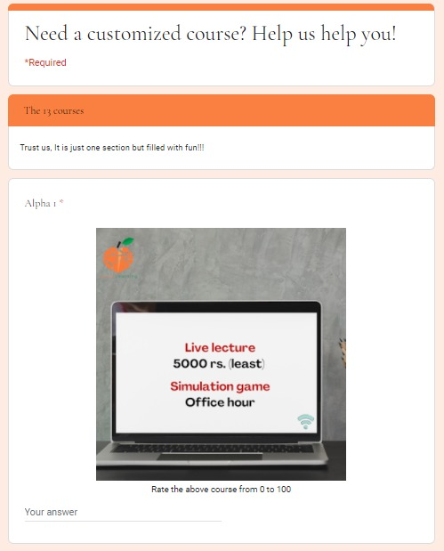

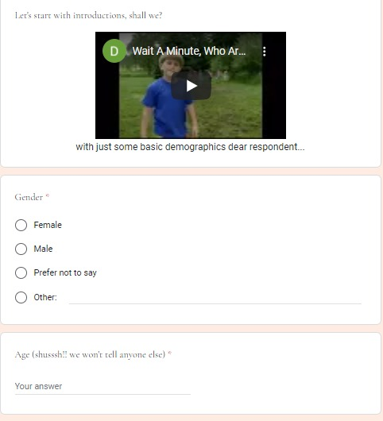
Survey Screenshot

Slide 11
Preference partworths
 | Average | Std dev. | Minimum | Maximum
5000 (the least price) | 22.8 | 20.9 | 0.0 | 69.0
7000 | 20.2 | 13.5 | 0.0 | 47.0
9000 (the highest price) | 1.6 | 4.7 | 0.0 | 27.3
live | 17.6 | 17.1 | 0.0 | 65.8
recorded lecture | 3.5 | 7.3 | 0.0 | 32.2
live + recorded lecture | 20.5 | 17.1 | 0.0 | 59.7
simulations game | 17.3 | 17.2 | 0.0 | 60.0
online mcq quizzes | 6.8 | 13.3 | 0.0 | 60.0
individual project | 20.3 | 15.5 | 0.0 | 55.2
office hours | 3.9 | 8.9 | 0.0 | 41.9
career-mentorship | 15.2 | 15.1 | 0.0 | 55.1
Average and standard statistics for preference partworths.

Slide 12
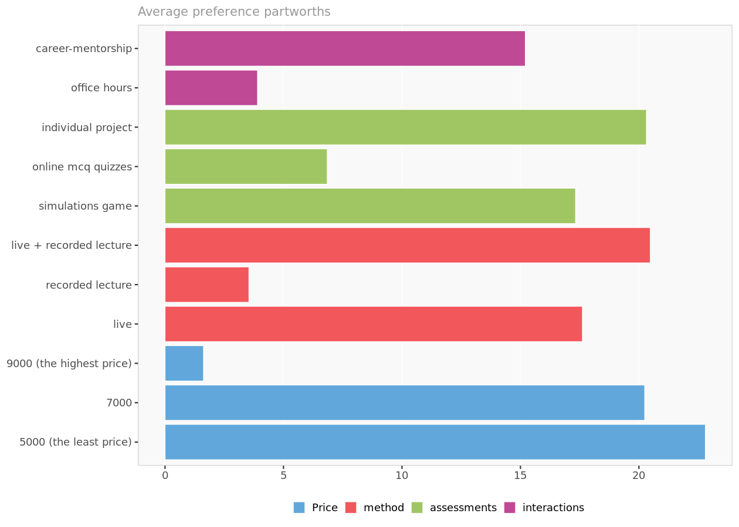
Preference partworths
Average preference partworths for each attribute level.

Slide 13
Attributes to focus on
A view of the following chart of preference partworths (indicating the relative importance for each of the attributes) suggests that a price is of significance for the potential target market and of course they are preferring the level where the price is minimum (PKR 5000 per course).
For the interaction attribute, the career mentorship, as it can be seen, is the highly preferred level. And as this is something that is not widely offered by competitors, in the future it can be effectively used as a source of competitive advantage specifically in area of Pakistan where unemployment is significantly rising and career mentorships are extensively needed to find the gaps of the probable careers within specific fields. And aptitude testing and career mentorships is still a huge gap in the e-learning platforms that can be filled.
Simulation games for attribute of assessments has also been the second most important level in terms of importance. As it can be seen from that chart of preference partworths in the next slide. This is another level with a lot of potential as most of the competitors are using the methods of mcq quizzes or individual projects for the assessments, however the data suggests that the target market might actually be giving more importance to simulation games even if it costs them more, as these games will make the both assessments and e-learning in general, more interactive.

Slide 14
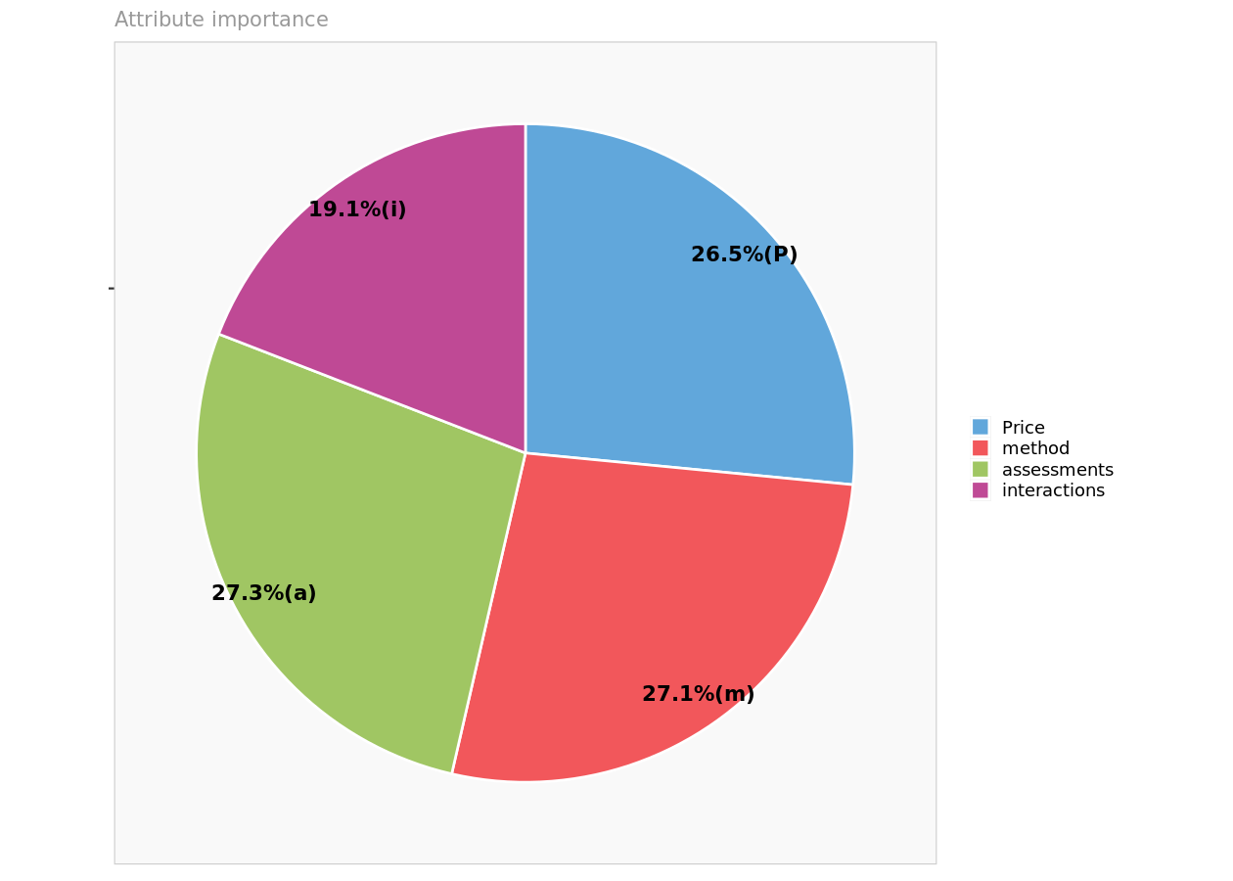
Attribute importance
Reports the maximum level value for each attribute, reflecting the relative importance of each attribute in driving preferences.

Slide 15
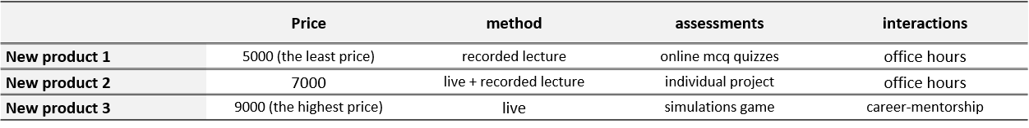
Economic feasibility to enter market
Enginius showed the following 7 feasible combinations for the defined levels of attributes for course offerings that will be producing the best market shares, named as New Product 1, New Product 2, New Product 3, Optimal Product 1, Optimal Product 2, Optimal Product 3, Optimal Product 4
 | Price | method | assessments | interactions
Optimal product 1 | 5000 (the least price) | live | simulations game | career-mentorship
Optimal product 2 | 5000 (the least price) | live + recorded lecture | simulations game | career-mentorship
Optimal product 3 | 5000 (the least price) | live | individual project | career-mentorship
Optimal product 4 | 5000 (the least price) | live + recorded lecture | individual project | career-mentorship

Slide 16
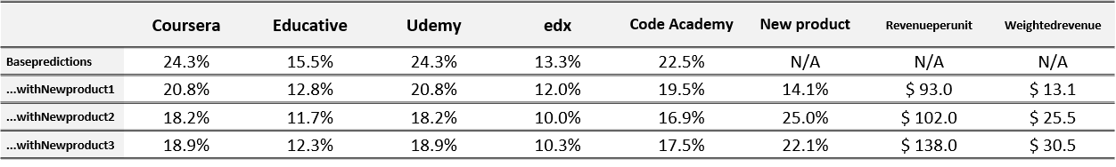
Economic feasibility to enter market
The below tables show us the predicted market shares of Peach Academy as compared to its competitors for each course offering
 | Coursera | Educative | Udemy | edx | Code Academy | Optimal product | Revenueperunit | Weightedrevenue
Basepredictions | 24.3% | 15.5% | 24.3% | 13.3% | 22.5% | N/A | N/A | N/A
...withoptimalproduct1 | 17.3% | 11.3% | 17.3% | 10.0% | 16.3% | 27.9% | $ 134.0 | $ 37.4
...withoptimalproduct2 | 17.0% | 11.4% | 17.0% | 9.8% | 16.1% | 28.6% | $ 122.0 | $ 34.9
...withoptimalproduct3 | 17.2% | 11.2% | 17.2% | 9.8% | 16.1% | 28.6% | $ 120.0 | $ 34.4
...withoptimalproduct4 | 17.0% | 11.2% | 17.0% | 9.6% | 15.9% | 29.3% | $ 108.0 | $ 31.7

Slide 17
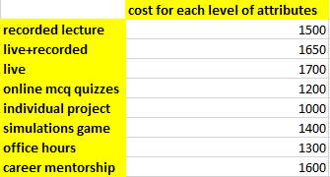
Economic Feasibility to enter the market-contd.
Following were the per course costs that are associated with the levels prescribed by Enginius.

Slide 18
Explanation of costs
All the cost data was acquired by the Peach Learning’ finance department.
They explained that the cost of live lecture delivery method is the highest as the instructors’ full time commitment is required. The instructor and support staff has to put in more effort in terms of explaining the concepts as well as answering the concepts. While in recorded session instructors’ efforts are relatively less. Once a session is recorded it can be re-run several times over different batches, while for each live online class presence of instructor and support staff is compulsory.
Getting software subscription from second party for simulations game is more costly then taking a quiz as well as assigning project. For quiz assessment as well a relatively less costly then simulations game application subscription is needed. Thus, it costs more then the simple instruction wise assignment of projects.
The career mentorship included many value added services. These services and interaction opportunities cost more. External consultants’ collaboration is often required that contributes to greater prices then simple instructors’ office hours held.

Slide 19
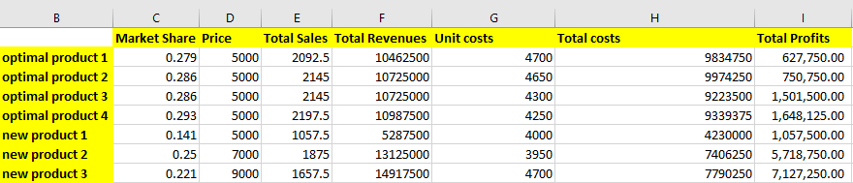
Economic Feasibility to enter the market-contd.
For a total target market size which is estimated to be around 7500 people and using the levels for attributes prescribed by Enginius following were the projected profits that were calculated. The net positive profits for all the optimal product listings given by enginius, suggests that it is indeed feasible to enter the e-learning market for Peach Learning.

Slide 20
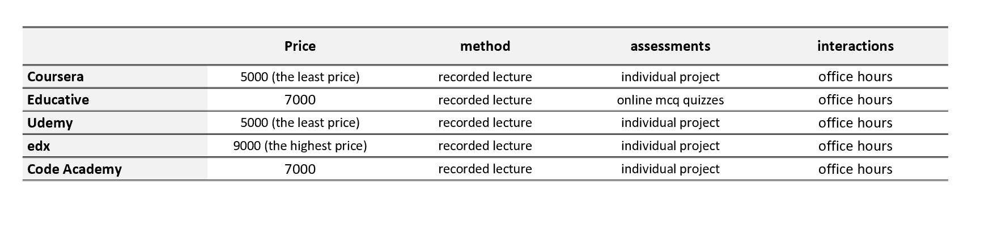
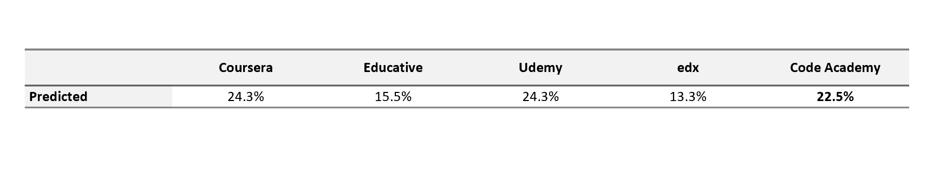
Competitors
The existing products of five of the key competitors of Peach Learning have been used for analysis. Their respective predicted Market shares. Details about their characteristics were accessed via secondary research online.

Slide 21
Description of Competitors
Competitors such as Udemy and Coursera have models which work on similar attributes as Peach Learning’s
Price is a major driver in eLearning platforms
Our lecture delivery and interaction methods are also in line with our competitors
Assessment methods are also a plus point as many of our competitors are testing on individual projects but not on simulation games (future seeking)
Thus, these defined attributes are significant in eLearning industry and can prove vital for decision during conjoint analysis
Among several other attributes and levels these attributes and their respective costs were identified. This was done to make a fair comparison between peach learning and competitors market shares.
Online official websites were used to gather competitors’ data. identification of competitor was done via three lens; the Peach Learning personnel interview, secondary literature review, and customers’ responses via focus groups.

Slide 22
Share of preferences used
In this regard it was important to understand who is making the decision i.e to look at the target audience’s prospective and then decide which rule to choose.
As our target audience belongs to upper middle and upper economic class students, they don’t see this as a high customer involvement decision. Thus instead of using maximum utility the share of choice method is used.

Slide 23
Simulations with new products

Slide 24
Preference partworths (excerpt)
 | 5000(theleastprice) | 7000 | 9000(thehighestprice) | live | recordedlecture | live+recordedlecture | simulationsgame | onlinemcqquizzes | individualproject | office hours | career-mentorship
1 | 29.05 | 29.79 | 0.00 | 11.18 | 0.00 | 14.63 | 30.56 | 0.00 | 11.15 | 25.02 | 0.00
2 | 8.80 | 9.34 | 0.00 | 0.00 | 13.67 | 4.21 | 30.44 | 0.00 | 33.36 | 0.00 | 43.63
3 | 40.31 | 24.42 | 0.00 | 0.00 | 27.16 | 39.87 | 10.18 | 0.00 | 14.53 | 5.29 | 0.00
4 | 13.33 | 8.88 | 0.00 | 27.72 | 0.00 | 40.17 | 11.15 | 0.00 | 22.63 | 0.00 | 23.88
5 | 65.77 | 44.12 | 0.00 | 0.88 | 0.00 | 16.48 | 0.00 | 12.98 | 9.13 | 4.77 | 0.00
6 | 21.91 | 15.04 | 0.00 | 18.09 | 0.00 | 12.87 | 37.90 | 0.00 | 36.98 | 0.00 | 22.11
7 | 0.00 | 5.46 | 7.44 | 20.03 | 0.00 | 21.23 | 27.71 | 0.00 | 55.18 | 0.00 | 16.14
8 | 46.11 | 29.89 | 0.00 | 40.45 | 0.00 | 40.26 | 13.07 | 0.00 | 11.05 | 0.37 | 0.00
9 | 3.31 | 10.97 | 0.00 | 0.00 | 3.83 | 13.68 | 0.00 | 60.04 | 47.92 | 15.31 | 0.00
10 | 18.81 | 19.86 | 0.00 | 55.63 | 0.00 | 42.41 | 0.00 | 6.03 | 3.53 | 0.00 | 18.48

Slide 25
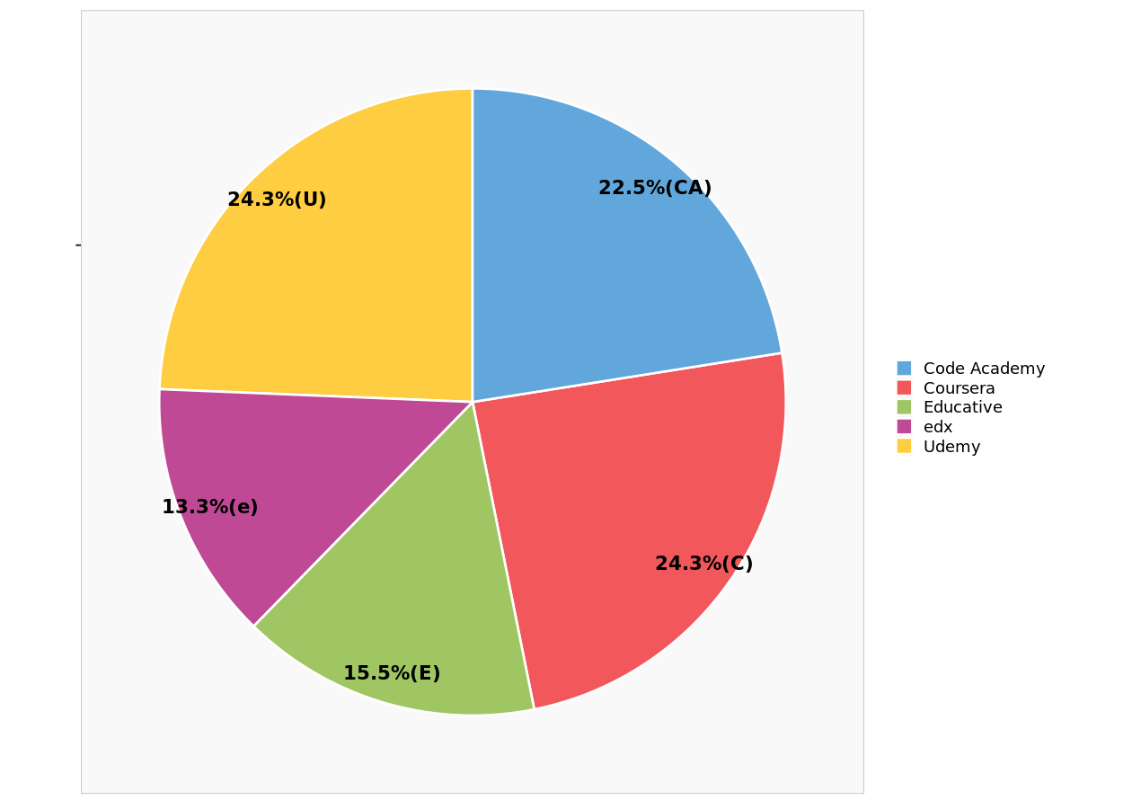
Predicted market shares

Slide 26

Proposed New Product
Proposed new product

Slide 27
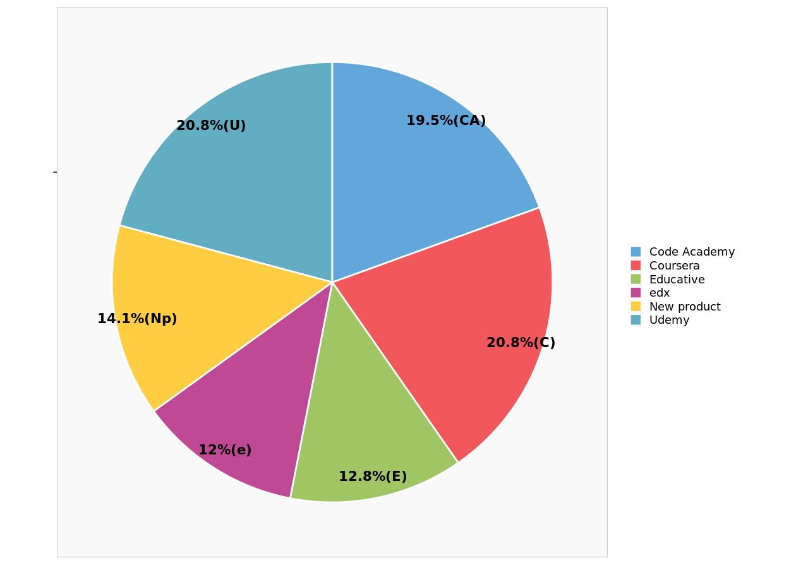
NP-1

Slide 28
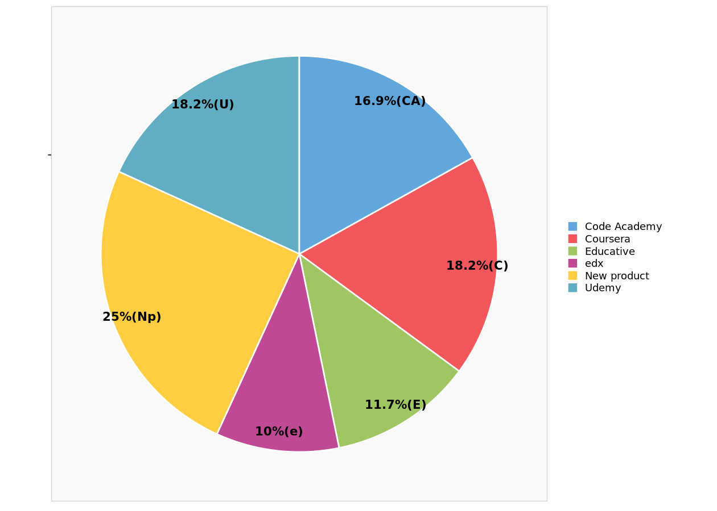
NP-2

Slide 29
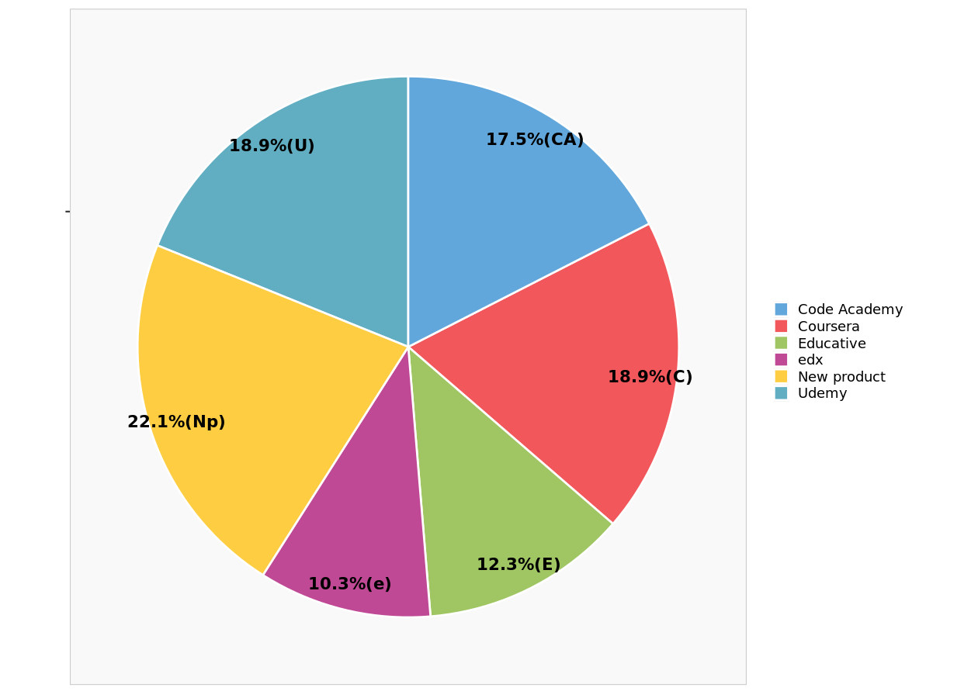
NP-3

Slide 30

We will be launching NP-2:
Gaining highest market-share of 25% among all three.
Compared to NP-3, NP-2 offers a lower price of Rs 7000.
Peach learning is a new venture which believes in providing the educational needs of the larger market while strengthening its own roots.
Market share matters because it allows future growth and ultimately drives competition out of the market, creating the opportunity for becoming the market leader.
Long-term plan to reduce further prices after attainting a certain position (share).

Slide 31
Simulations with optimal products

Slide 32
We want to see what market shares and revenues our Enginius recommended optimal products will generate

Slide 33
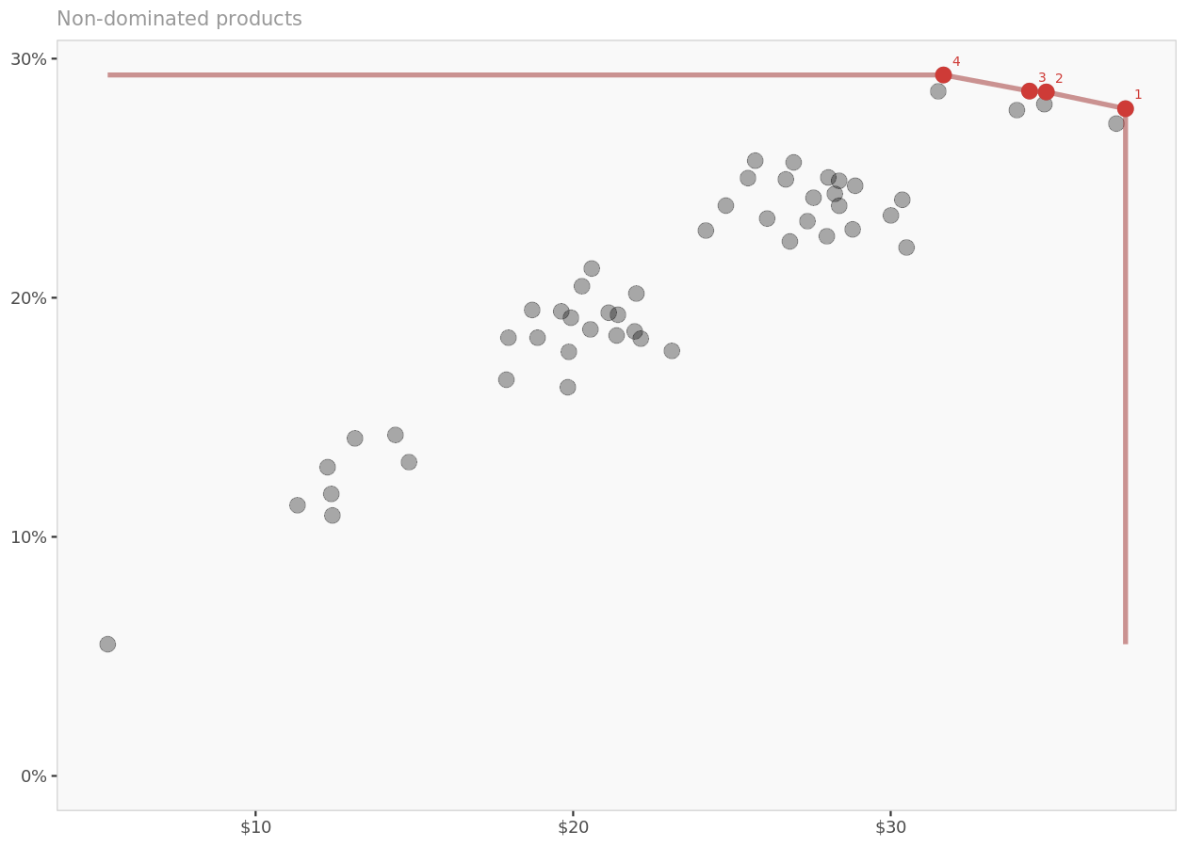
Pareto frontier
Non-dominated products (in terms of market shares and weighted revenue) are in red, dominated products are in gray, and the red line represents the Pareto frontier.

Slide 34
Which optimal product should we go with? analysis with respect to market share and revenue
Based on the number of attributes and attribute levels, there is a total of 54 possible product combinations that could be formed.
We report the characteristics of the 4 non-dominated products among those 54 combinations. A product is said to be non-dominated when there is no other product that provides at the same time a higher predicted market share and a higher weighted revenue.

Slide 35
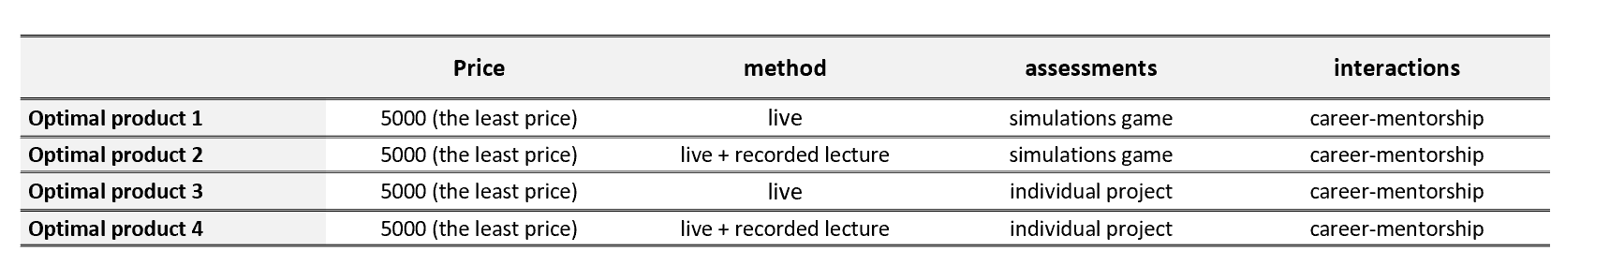
Optimal products characteristics
We have 4 new products that will be introduced one by one in the market and compute their market share.
Each of the attributes of the products have been shown to us.
It is noticeable that the price levels of all 4 courses are the least.
All the methods do use live classes as an on whole medium of teaching or in mix with the recorded sessions.
It is also noticeable that among interactions all 4 of the optimal products have career- mentorship instead of office hours.
The assessments do not include MCQ based quizzes in any of the 4 optimal products shown

Slide 36
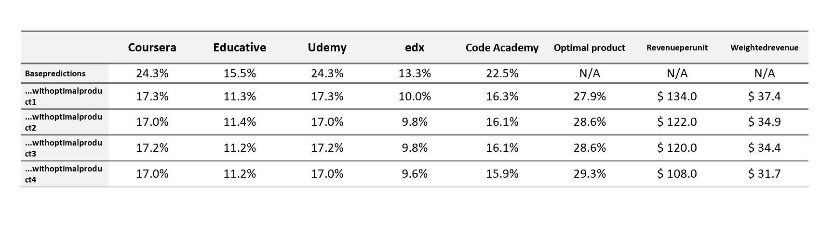
Simulations Results
If Peach Learning introduces optimal product 1 with its attributes, then this course relative to other will be able to generate a market share of 27.9%, the product 2 will generate 28.6 % while product 3 and 4 generate 28.6 and 29.3% market shares respectively and relative to other courses.
Based on the analysis of weighted revenues product1 seems to have the highest weighted revenues.
Based on the analysis of market share product 4 seems to have the highest value.

Slide 37
Conclusion: Product 4 is chosen
In order to make a final decision about launching of optimal product it is important to understand the managerial point of view.
Peach learning is a startup it has it’s focus on growth instead of profitability.
The brand image has not yet been created; the founders of Peach Learning thus aim for spreading brand awareness instead of focusing on gaining profits.

Slide 38
Hypothesis testing
We ran to Hypothesis tests to check whether there is a significant difference in the levels of each attribute.
This would represent the features that stand out.
Null Hypothesis: There is no significant difference between 2 variables
Type of test: independent sample t-testing
In this analysis we will be using confidence interval of 95%.
Criteria: if p-value < 0.05 then reject Null hypothesis

Slide 39
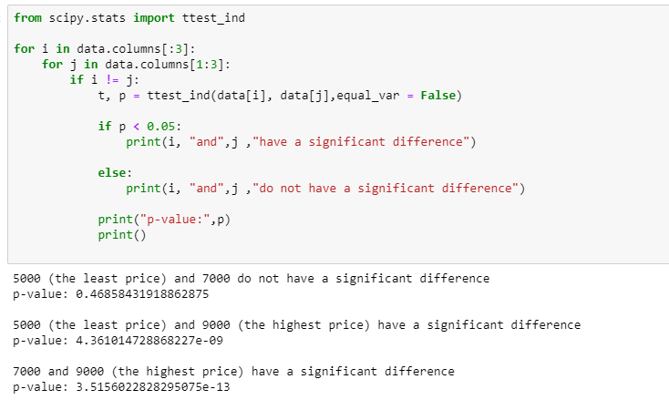
Hypothesis testing - Price
5000 and 7000 price do not have any significant difference, hence it has the same preference in the mind of customer. Therefore, using either one of them would mean same for customers.
Although jumping to the price of 9000 causes a significant difference. Hence, it represents a totally different perception in the mind of customers.

Slide 40
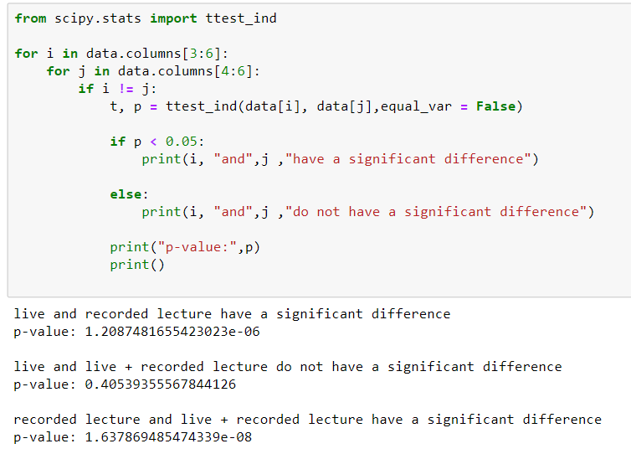
Hypothesis testing – Teaching methodology
Recorded lecture have a significant difference in their preference in either combination. With Live and with recorded lecture.
Whereas live and live + recorded lectures do not have any difference in the customer preference. Which means if we offer either one of them, it will mean exactly same in the long run.

Slide 41
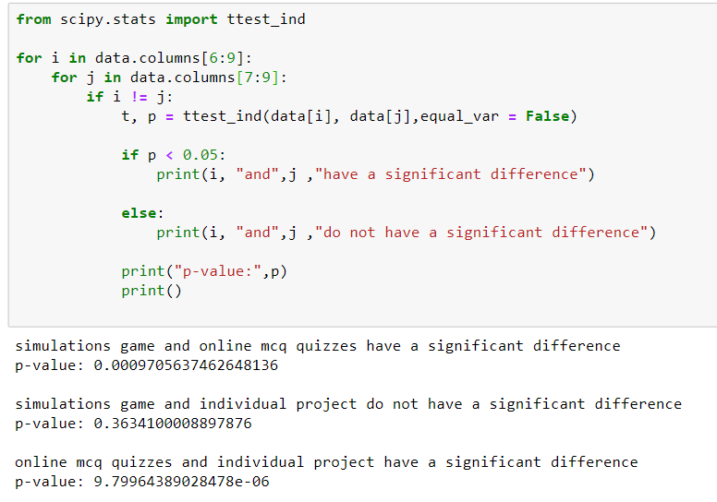
Hypothesis testing – Assessment
Online MCQ quizzes have a significant difference in their preference in either combination. With simulation game and with individual project.
Whereas simulation game and individual project do not have any difference in the customer preference. Which means if we offer either one of them, it will mean exactly same in the long run.

Slide 42
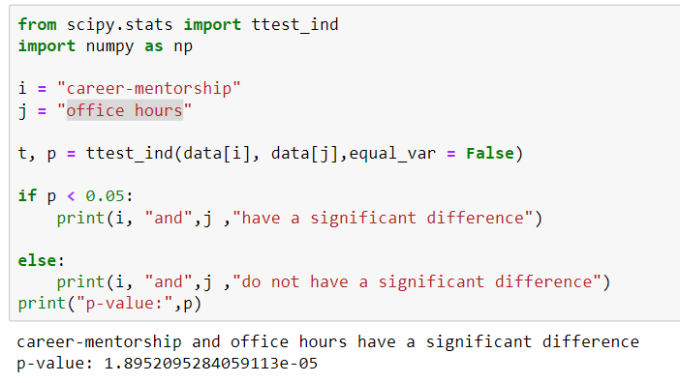
Hypothesis testing – interaction
Career mentorship and office hours have a significant difference among themselves. Which means that they have a very different perception in the mind of customers. Hence, we can extract 2 very different value services by offering each one of them.

Slide 43
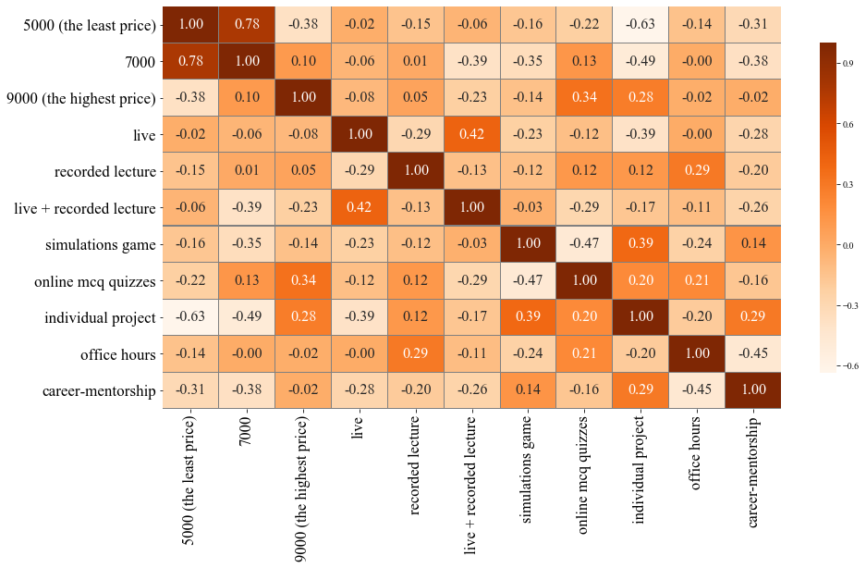
Correlation among features
Correlation among all the features will let us know which features have a linear relationship among themselves. Which will help us decide which features should be offered together and which should not.

Slide 44
Correlation among features - Heatmap
Heatmap shows that there are a couple of very important relations.
5000 and 7000 price have 78% correlation. Which is a positive strong correlation. Which means that customers who prefer Rs.5000 also prefer Rs.7000.
Price of 5000 and individual project have -63% correlation. Which is negative and strong correlation. Which means that customers who prefer one, does not prefer the other. Hence, we should not offer them together.
Price of 5000 and individual project have -49% correlation. Which is negative and mildly strong correlation. Which means that some customers who prefer one, does not prefer the other. Hence, ideally we should not offer them together.
Career mentorship and office hours have a correlation of -45%. Which is mildly strong and negative. Hence, this once again proves that there is a significant difference between the two.

Slide 45
Which features should be kept together?
After statistical analysis with the help of hypothesis testing and correlations heatmap. We can suggest some product features in our final product to yield the optimal customer preference.
We do not need separate offering for Rs.5000 and Rs.7000. Offering one of them will yield sufficient results. Although we should offer Rs.9000 courses separately.
We do not need separate offering for live and live + recorded lectures. Offering one of them will yield sufficient results. Although we should offer recorded courses separately.
We do not need separate offering for simulations and individual project courses. Offering one of them will yield sufficient results. Although we should offer online MCQs separately separately.
Similarly there should be separate offering for mentorship enabled courses and courses with office hours option.
We should not offer Rs.5000 courses with individual project assessment method

Slide 46
Evaluations part worth preference values
Enginius is suggesting the attribute part worth preference on the basis of arithmetic mean. But there are several other factors which make this mean reliable or not. Which include, variations, ranges, interquartile range, probability density and outliers.
We will analyze all of these characteristics through violin plots.

Slide 47
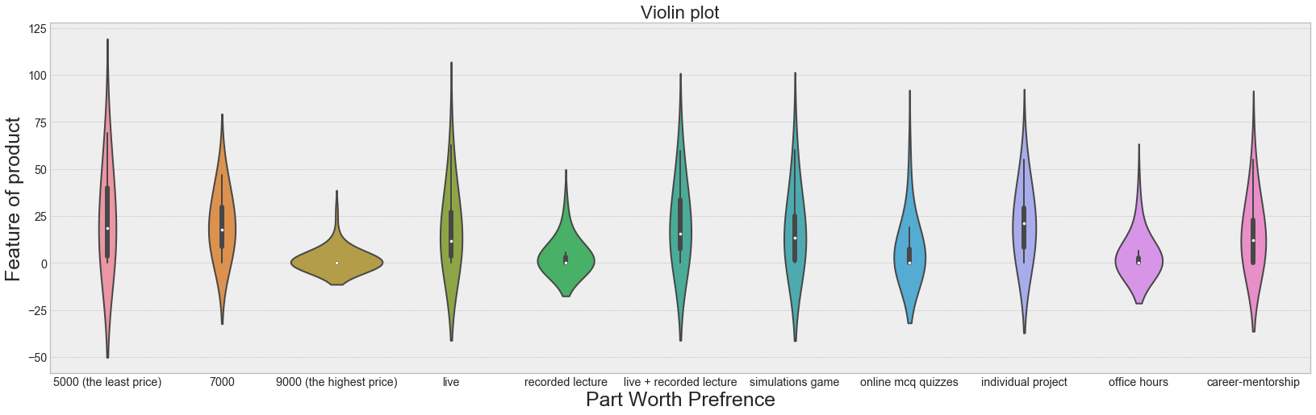
Evaluations part worth preference values
Bar inside every graph represents the 50% values, lines across them represents other 25% values on each side. This is important to analyze the ranges and interquartile ranges in our data.
The hues around them represent the probability density. Curves represent the frequency.

Slide 48
Evaluations part worth preference values
We can observe that the values in the features, price Rs.9000, recorded lectures, online MCQ quizzes and office hours. The values are amalgamated around 0. As they have the highest curves there, hence, high density. Although online MCQs has a relatively higher cummulation bar, this means that some people have rated it higher as well. Moreover, all inside bars are very squeezes and small. This means that most of the people have show preference around 0 in them.
We can also observe that, the distribution of live lectures, live + recorded lectures, simulations games, individual project and career mentorship have a very similar graphs. With 50% values above 10, and outliers in the above 25% region. And most the values have a huge spread, which means high variation.
Courses of price 7000 have a thick density around 20. 50% of the values are also in the range of 10 and 20. Which shows low variation. Where are there are fair amount of values on the either side.
Courses of price 5000 have the highest spread. With 50% values in the range of 5 to 45. Which shows high variation. And upper 25% values are ranging up till 70. Which is the highest preference. Hence, we can say that this feature has highest volatility, but also high preference.

Slide 49
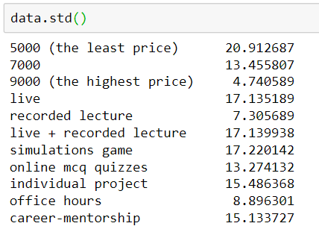
Evaluations part worth preference values
We are certain about the mean of features, price Rs.9000, recorded lectures, online MCQs and office hours. As they are verified unpopular features now.
From the given observations we can conclude that the we need to be cautious about relying on the mean of feature, Rs.5000 and live courses.
Whereas there is a volatility in other features too, especially in live + recorded lectures simulations game, individual project and career-mentorship. Therefore, we need to be cautious about them too. As in the customer segment there is a huge variation in the preference for these features.
This can be confirmed from the following standard deviation table too.

Slide 50
Optimal or New Product
The heuristic which we would be utilizing for choosing a product between optimal or new product would be that of market share.
This assumption is made by keeping in mind that we are a startup
Market Penetration is the most ideal strategy we can go for.
Below are the respective market shares of each category:
New Product 2 | Optimal Product 4
25% | 29.3%

Slide 51
Continued…
If we want to launch one product, we would choose optimal product 4, allowing us to capture a market share of 29.3%
The attributes of this product are:
Demographics:
About 80% of the people who went for this
product were from Lahore, therefore in order to
penetrate market discounts can be issued.
Rs. 5000 | Live + Recorded | Individual Project | Career Mentorship

Slide 52
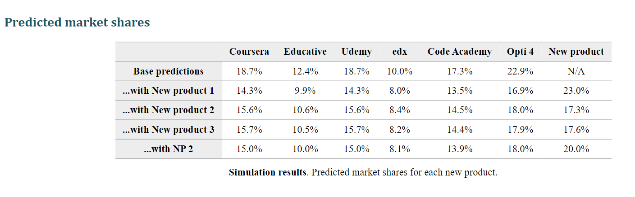
More than one Offering
We did an analysis if we are launching 2 products in market.
This would help us to study the cannibalization or joint effect of both products.
We did this analysis for several combinations of optimal products and new products.
The maximum market share was achieved by launching NP2 and optimal product 4.
The cumulative market share from these 2 offerings was 38%.

Slide 53
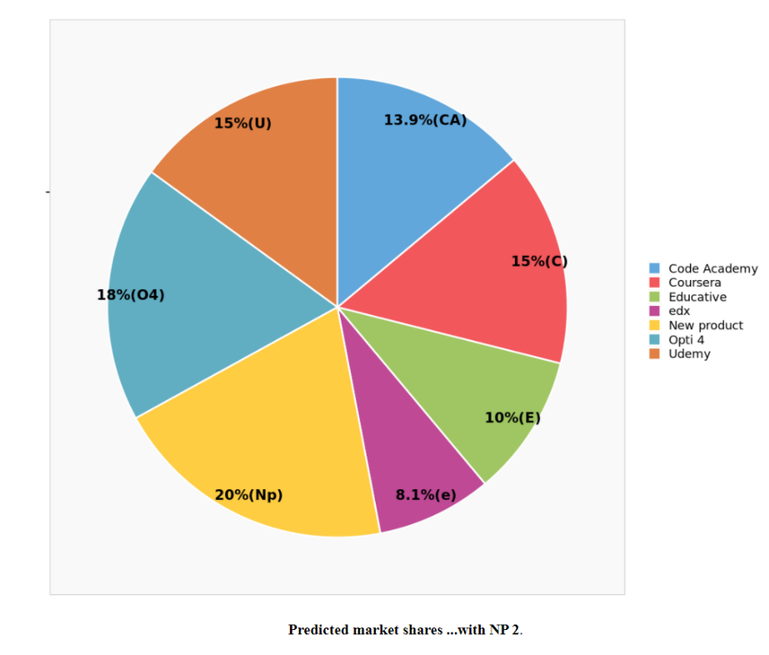
Continued…
All other combinations led to a lesser market share.
NP 2 contributes 20% and Optimal product 4 contributes 18% in market share.
The attributes of both these products are already mentioned above.
Therefore, we observe an appreciation in market share by launching 2 offerings.
This is also in alignment with our market penetration strategy.

Slide 54
Limitations
The competitors that we have mentioned in our model are not the only ones who exist. In real life a lot of other elearning platforms exist which Peach Learning is competing with regionally and globally as well. Due to those competitors, the real-life market share values will vary a lot. And as the porter’s forces suggest that 5 forces determine the competitive environment, thus substitutes for e learning, power of suppliers, power of buyers and threat of new entrants will impact the market share and the respective profits as well as the overall strategic decision making
According to model, when we introduce the new optimal product in the market, the market shares of competitors fall proportionally, which is quite unrealistic when it comes to real life.
The strategy mainly focuses on a red ocean marketing strategy where marketing strategy is being defined in a market where a fierce competition with a lot of competitors exist. Thus, the model sidelines the possibility of a blue ocean strategy to tap the market in an entirely new way.

Slide 55
Assumptions
No reaction by the competitors in response to the new products launched in the market
Customers preferences remains the same throughout the process.
The time value of money remains constant through out the process.
Political, social, technological and economic environments remain constant

Slide 56
Recommendation
Peach learning should choose the optimal product 4.
As after the statistical study and conjoint analysis the combination present in these products represent the best mix.
As they are a startup so they should focus on the market penetration, hence, low price is suitable for them.
Along with that people are more comfortable with the existing features, that they are already using in their university. Hence, initially peach learning should focus on that.
In future they can start introducing new features like simulation games and other options.
It can be checked if the customers are sensitive to the market share rule used. Some of the students may find the decuision of buying online course as high involvement thus the first-choice rule can be used instead of share of preference rule.

Slide 57
Appendex
Survey: https://docs.google.com/forms/d/e/1FAIpQLSelGBZ6ZSminEHjMrMzsBhoiVdUeQV-16aNBW501wjdGb_IBQ/viewform?usp=sf_link
Data:
https://docs.google.com/spreadsheets/d/1aLkRsGR_mScFqydIqgq2UXxGlK-BURbV16Yk_Qdp3y0?usp=forms_web_b#gid=81803250

